Slide 1
A Simple SQL Extension
CS562 Project
Vladislav Ligai

Slide 2
Introduction
What I’m about to present
Problem with MF/EMF queries using regular SQL
Succinct representation of ad-hoc OLAP queries
Grouping Variables
Such That clause

Slide 3
Introduction
Demo Presentation Overview
High Level Architecture diagram
Show Input file structure
Description of technology
Technical limitations
Generate java file using an input file
Run the generated java file to get output

Slide 4
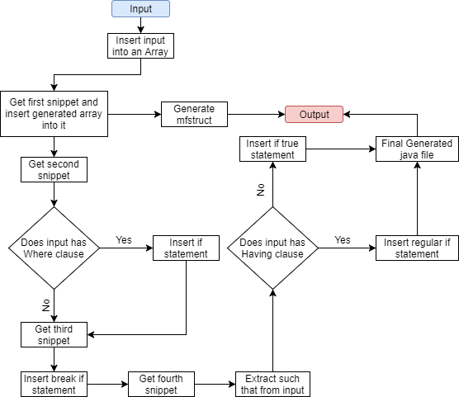
Demo
High Level Architecture Diagram

Slide 5
Demo
Description of the Query Structure
List of parameters to the Phi operator
Where clause on the last line

Slide 6
Demo
Description of Technology
Language: Java
PostgreSQL: jdbc driver to connect
Java imports to read file/input, establish connection with the DB, check for exceptions etc.

Slide 7
Demo
Technical limitations
Error Checking
Doesn’t check user input

Slide 8
DEMO!

Slide 9
Closing Statement and Future Work
Could use some future work
Update_mfstruct

Slide 10
Thank You

